Slide 1
LINEAR PROGRAMING PROBLEMS

Slide 2
PROBLEM 1
A manufacturer produces two types of models M1 and M2. Each model of the type M1 requires 4 hours of grinding and 2 hours of polishing; where as each model of M2 requires 2 hours of grinding and 5 hours of polishing.
The manufacturer has 2 grinders and 3 polishers.
Each grinder works for 40 hours a week and each polisher works 60 hours a week.
Profit on M1 model is Rs.3.00 and on model M2 is Rs.4.00.
Whatever produced in a week is sold in the market.
How should the manufacturer allocate his production capacity to the two types of models, so that he makes maximum profit in a week?

Slide 3
PROBLEM 2
A firm can produce 3 types of cloth, A , B and C. 3 kinds of wool are required Red, Green and Blue.
1 unit of length of type A cloth needs 2 meters of red wool and 3 meters of blue wool.
1 unit of length of type B cloth needs 3 meters of red wool, 2 meters of green wool and 2 meters of blue wool.
1 unit type of C cloth needs 5 meters of green wool and 4 meters of blue wool.
The firm has a stock of 8 meters of red, 10 meters of green and 15 meters of blue.
It is assumed that the income obtained from 1 unit of type A is Rs.3, from B is Rs.5 and from C is Rs.4.
Formulate this as an LPP

Slide 4
PROBLEM 3
The agricultural research institute suggested the farmer to spread out atleast 4800 kg of special phosphate fertilizer and not less than 7200 kg of a special nitrogen fertilizer to raise the productivity of crops in his fields. There are two sources for obtaining these – mixtures A and mixtures B.
Both of these are available in bags weighing 100kg each and they cost Rs.40 and Rs.24 respectively.
Mixture A contains phosphate and nitrogen equivalent of 20kg and 80 kg respectively, while mixture B contains these ingredients equivalent of 50 kg each. Write this as an LPP and determine how many bags of each type the farmer should buy in order to obtain the required fertilizer at minimum cost.

Slide 5
PROBLEM 4
A farmer has a 100 acre farm. He can sell all tomatoes, lettuce or radishes and can raise the price to obtain Rs.1.00 per kg. for tomatoes , Rs.0.75 a head for lettuce and Rs.2.00 per kg for radishes. The average yield per acre is 2000kg.of tomatoes, 3000 heads of lettuce and 1000 kgs of radishes. Fertilizers are available at Rs.0.50 per kg and the amount required per acre is 100 kgs for each tomatoes and lettuce and 50kgs for radishes. Labour required for sowing, cultivating and harvesting per acre is 5 man-days for tomatoes and radishes and 6 man-days for lettuce. A total of 400 man-days of labour are available at Rs.20.00 per man-day. Formulate this problem as LP model to maximize the farmers profit.

Slide 6
PROBLEM 4.1
A firm manufactures Headache pills in two sizes: size A and size B.
Size A contains 2 grams of Aspirin, 5 grams of Bicarbonte, 1 gram of Codine
Size B contains 1 gram of Aspirin, 8 grams of Bicarbonte, 6 grams of Codine
It is found that it requires atleast 12 grams of Aspirin
74 grams of Bicarbonte, 24 grams of Codine for immediate effect.
It is required to determine the least number of pills a patient should take to gat immediate relief. Formulate the problem as LPP ?

Slide 7
PROBLEM 5
A Scrap metal dealer has received a bulk order from a customer for a supply of atleast 2000 kg of scrap metal. The consumer has specified that atleast 1000 kgs of the order must be high quality copper that can be melted easily and can be used to produce tubes. Further, the customer has specified that the order should not contain more than 200 kgs of scrap which are unfit for commercial purposes. The scrap metal dealer purchases the scrap from two different sources in an unlimited quantity with the following percentages (by weight) of high quality of copper and unfit scrap The cost of metal purchased from source A and source B are Rs.12.50 and Rs.14.50 per kg respectively. Determine the optimum quantities of metal to be purchased from the two sources by the metal scrap dealer so as to minimize the total cost

Slide 8
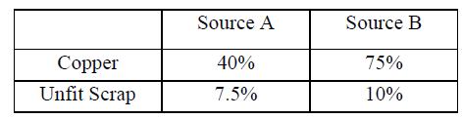

Slide 9
PROBLEM 6
A person requires 10, 12, and 12 units chemicals A, B and C respectively for his garden.A liquid product contains 5, 2 and 1 units of A,B and C respectively per jar. A dry product contains 1,2 and 4 units of A,B and C per carton. If the liquid product sells for Rs.3 per jar and the dry product sells for Rs.2 per carton, how many of each should be purchased, in order to minimize the cost and meet the requirements?

Slide 10
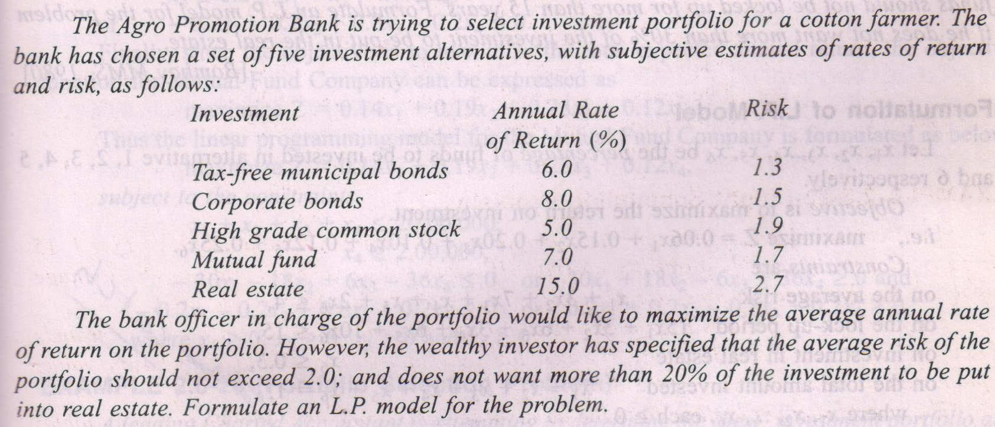
PROBLEM 7

Slide 11
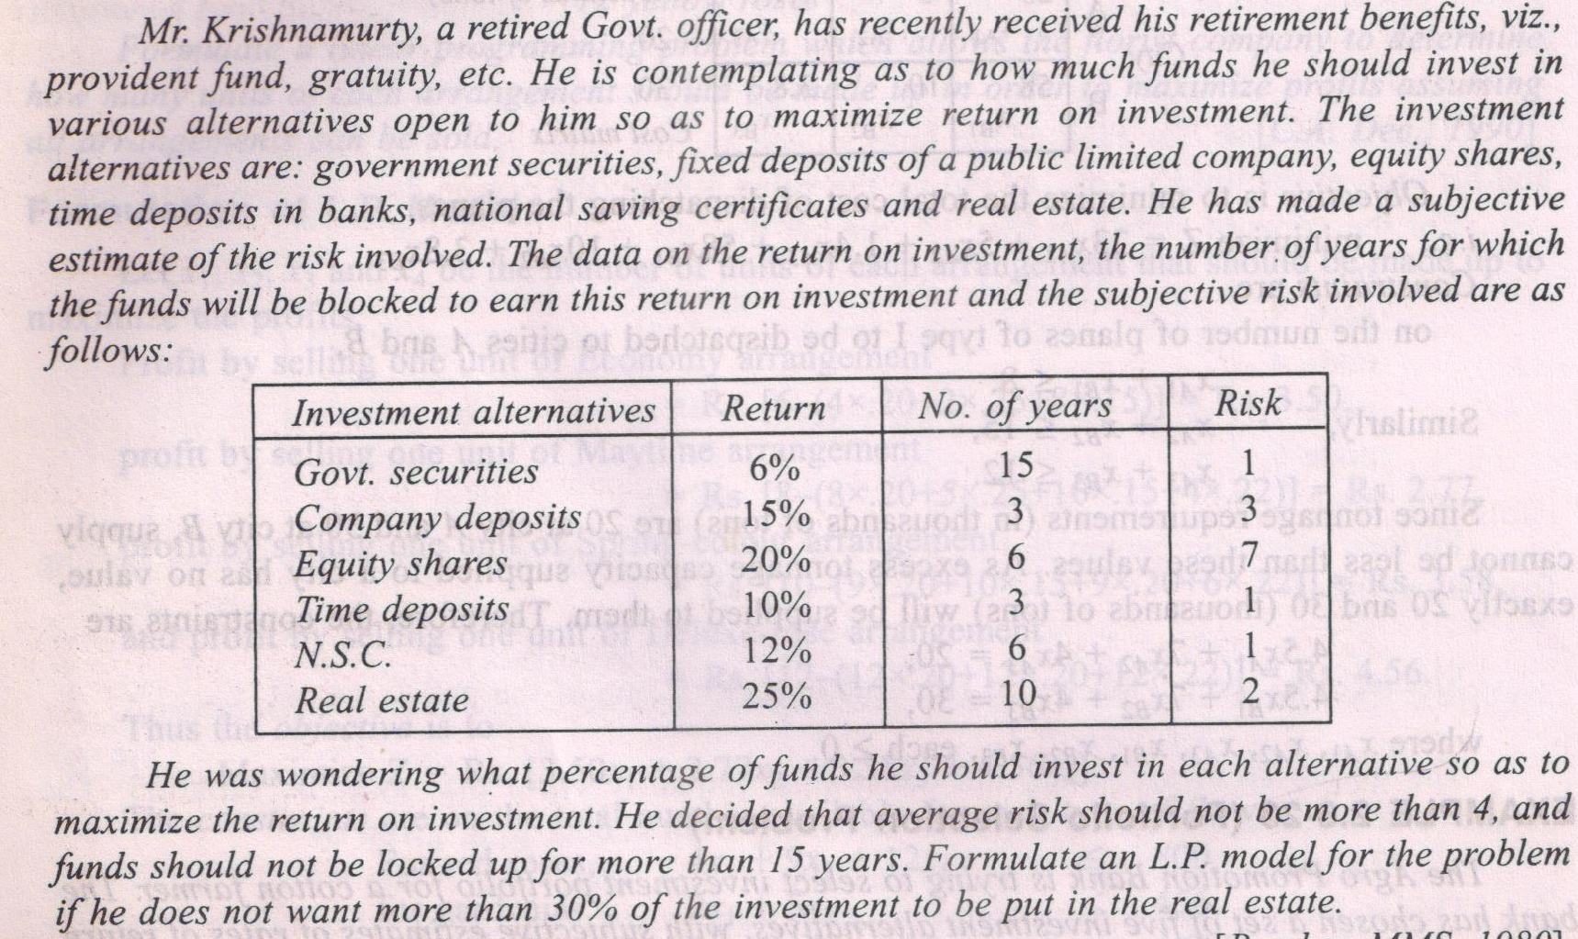
PROBLEM 8

Slide 12
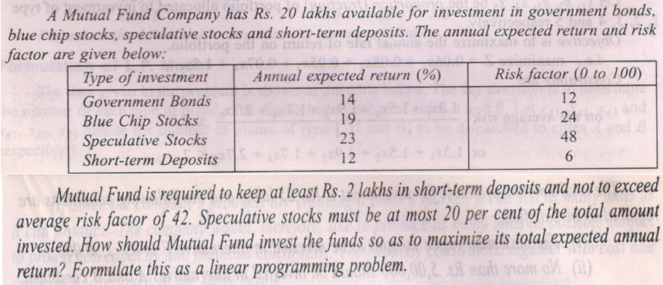
PROBLEM 9

